Slide 1
Reception | Give To Others | Advisor

Slide 2
Today’s Learning Objectives:
To use my Noticer skills to describe what I notice in my body.
To use my Advisor skills to think about why sharing can sometimes be hard.
To use my Advisor skills to help me share.
To Notice how it feels to share.

Slide 3
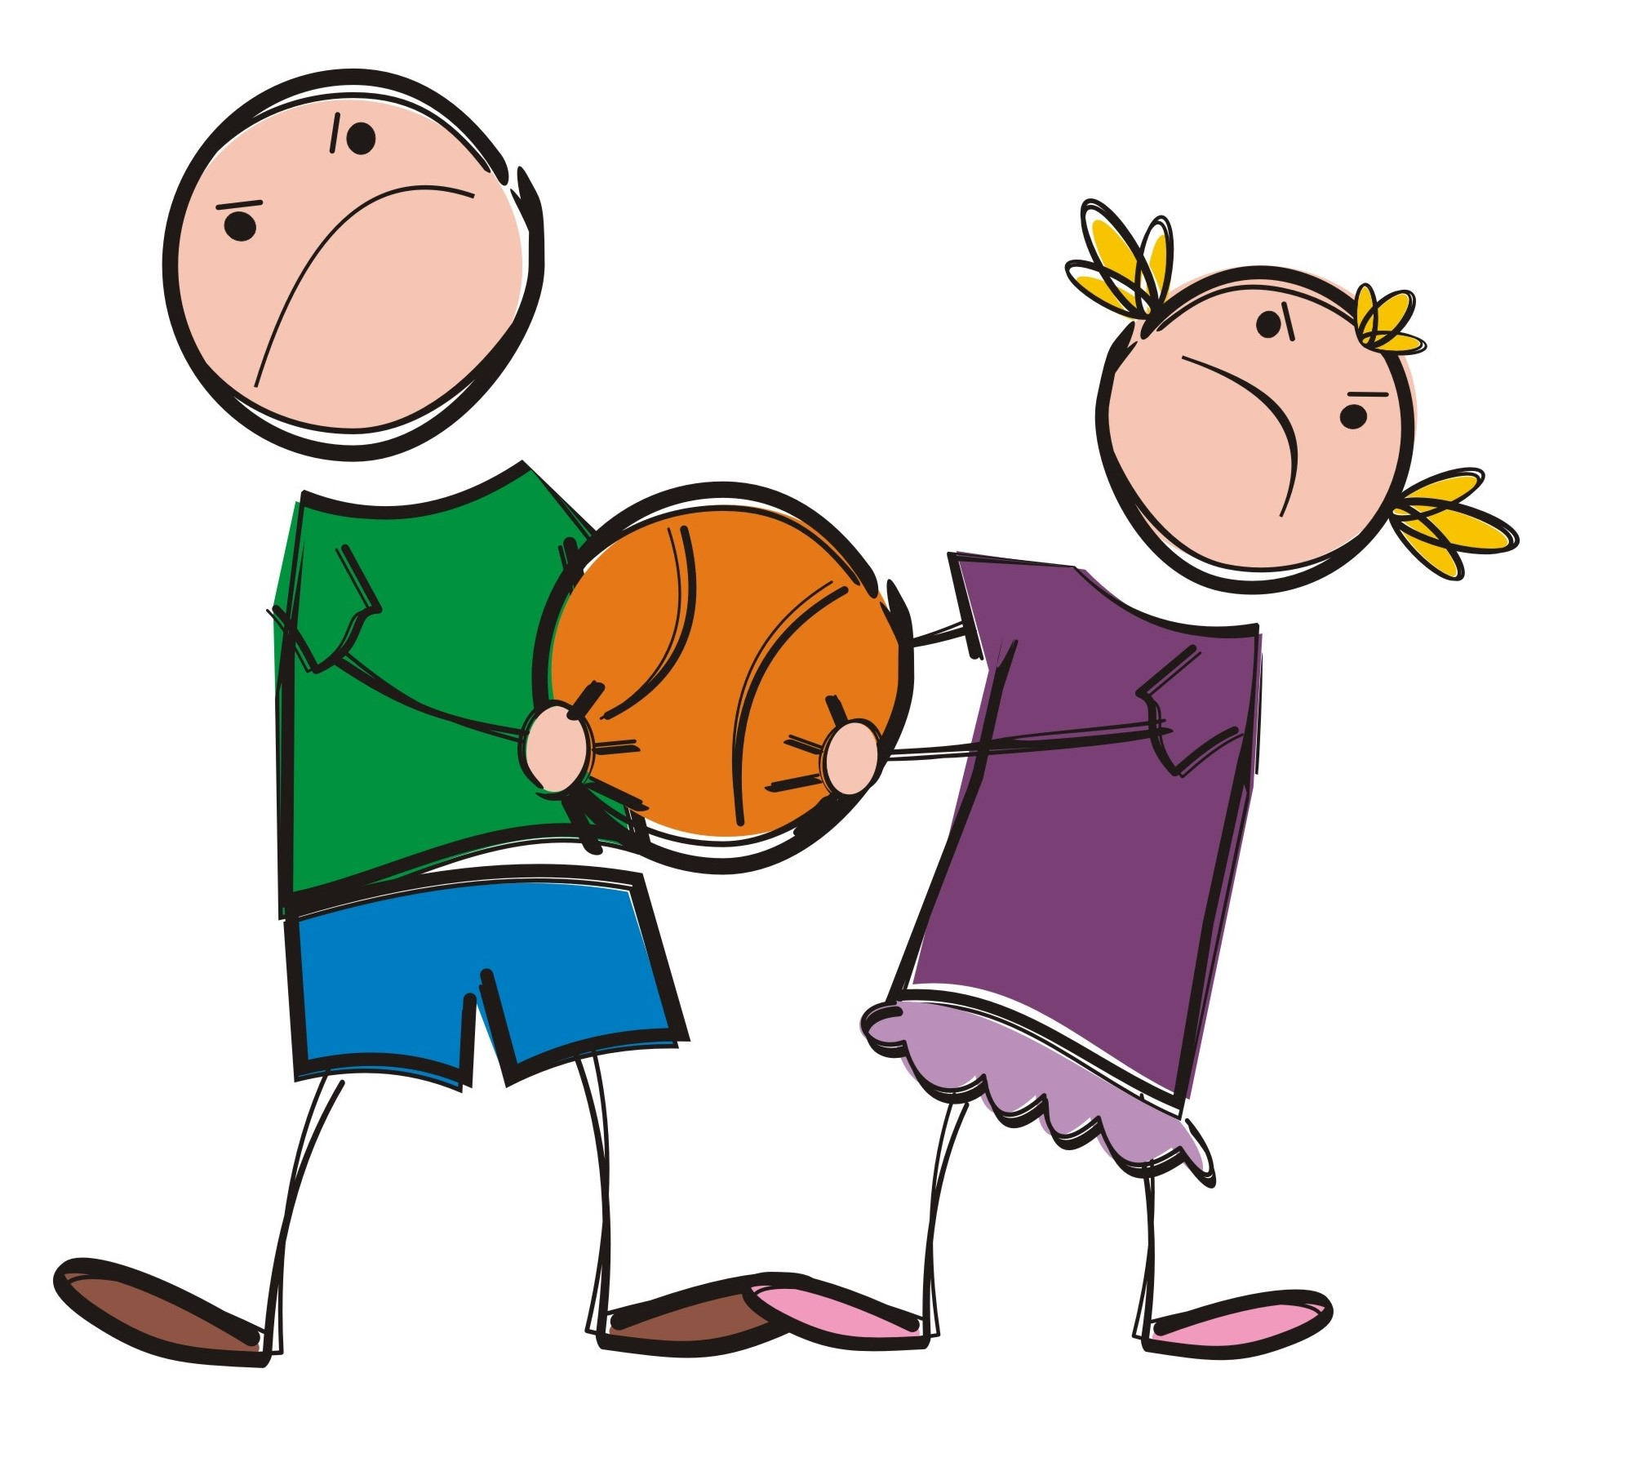
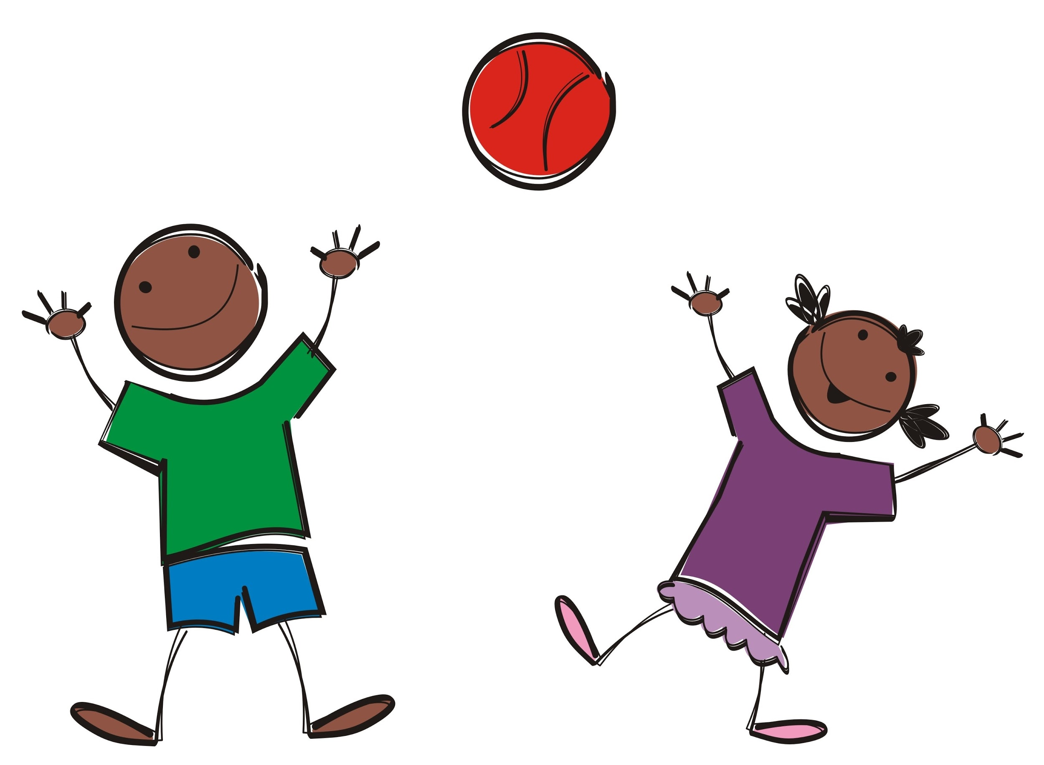
Advisor
Sharing Song
Click me!

Slide 4
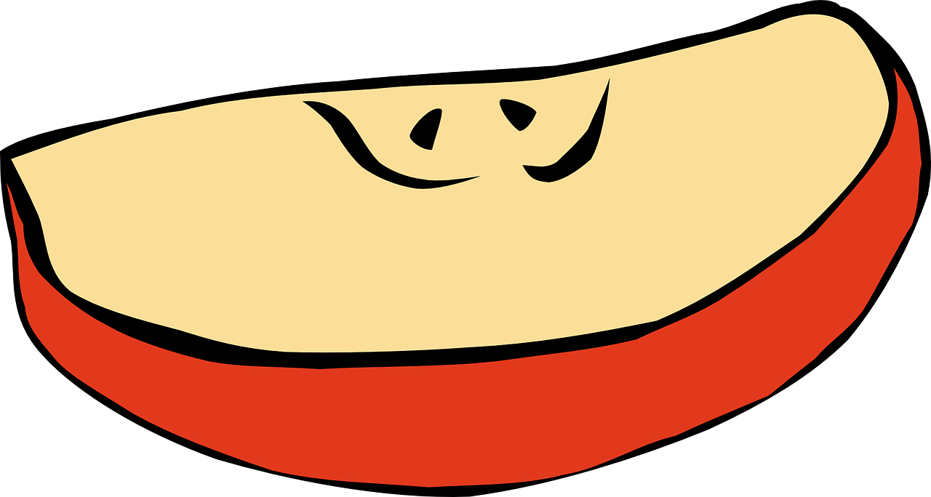
Advisor
Sharing Is Caring

